Slide 1

Customer Shopping Behavior Analysis
Uncovering insights from 3,900 transactions across product categories to guide strategic business decisions.

Slide 2
Dataset at a Glance
3,900
18
Purchases
Features
$59.76
3.75
Avg. Spend
Avg. Rating
Key features: demographics, purchase details, shipping, discounts, review ratings, and subscription status.

Slide 3

Data Preparation in Python
01
Load & Explore
Imported with pandas; used df.info() and .describe()
02
Clean & Impute
Filled 37 missing Review Ratings with category median
03
Feature Engineering
Created age_group and purchase_frequency_days
04
Load to PostgreSQL
Cleaned DataFrame pushed to database for SQL analysis

Slide 4
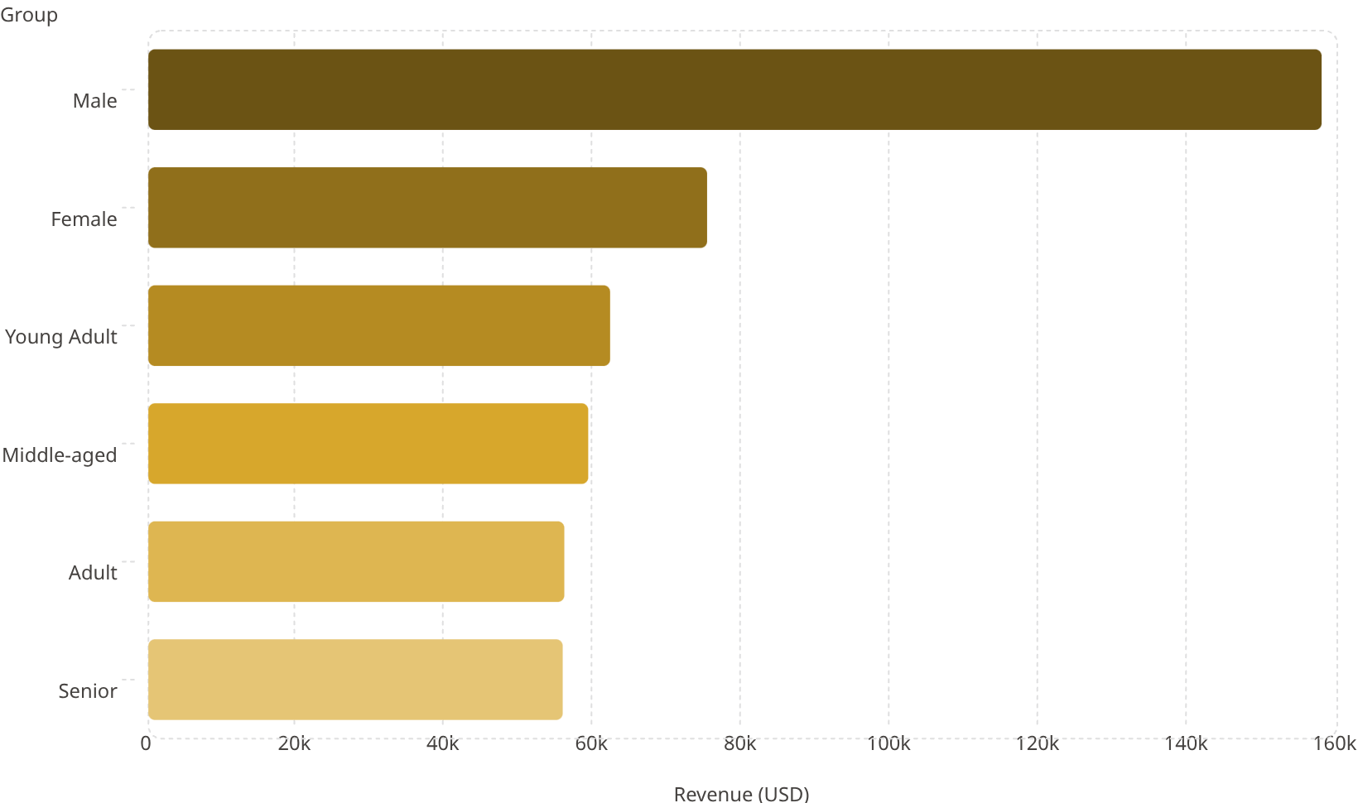
Revenue Insights
Key Takeaways
158k
Male customers generate 2× more revenue than female
Young Adults lead across all age groups
Revenue is relatively balanced across adult age segments
75.2k
62.1k
59.2k
56k
55.8k

Slide 5

Subscription vs. Non-Subscriber Spend
Subscriber Breakdown
Spend Comparison
Status
Customers
Avg Spend
Total Revenue
Subscribers
1,053
$59.49
$62,645
Non-Subscribers·73%
·73%
·
Subscribers·27%
·27%
·
Non-Subscribers
2,847
$59.87
$170,436
Avg spend is nearly identical — volume drives the gap, not loyalty spend.

Slide 6
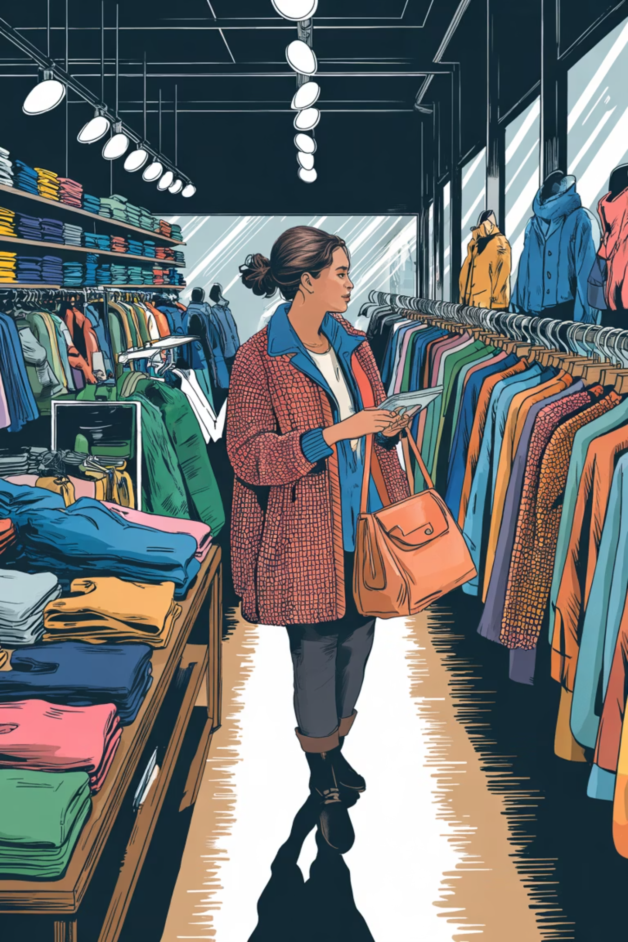
Top Products & Discount Dependency
Top Rated Products
Most Discount-Dependent
Gloves — 3.86 ⭐
Sandals — 3.84 ⭐
Boots — 3.82 ⭐
Hat — 3.80 ⭐
Skirt — 3.78 ⭐
Hat — 50%
Sneakers — 49.66%
Coat — 49.07%
Sweater — 48.17%
Pants — 47.37%

Slide 7

Customer Segmentation
3,116
701
83
Loyal
Returning
New
>5 purchases
2–5 purchases
First purchase
Of repeat buyers (>5 purchases): 958 subscribe vs. 2,518 do not — a major conversion opportunity.

Slide 8
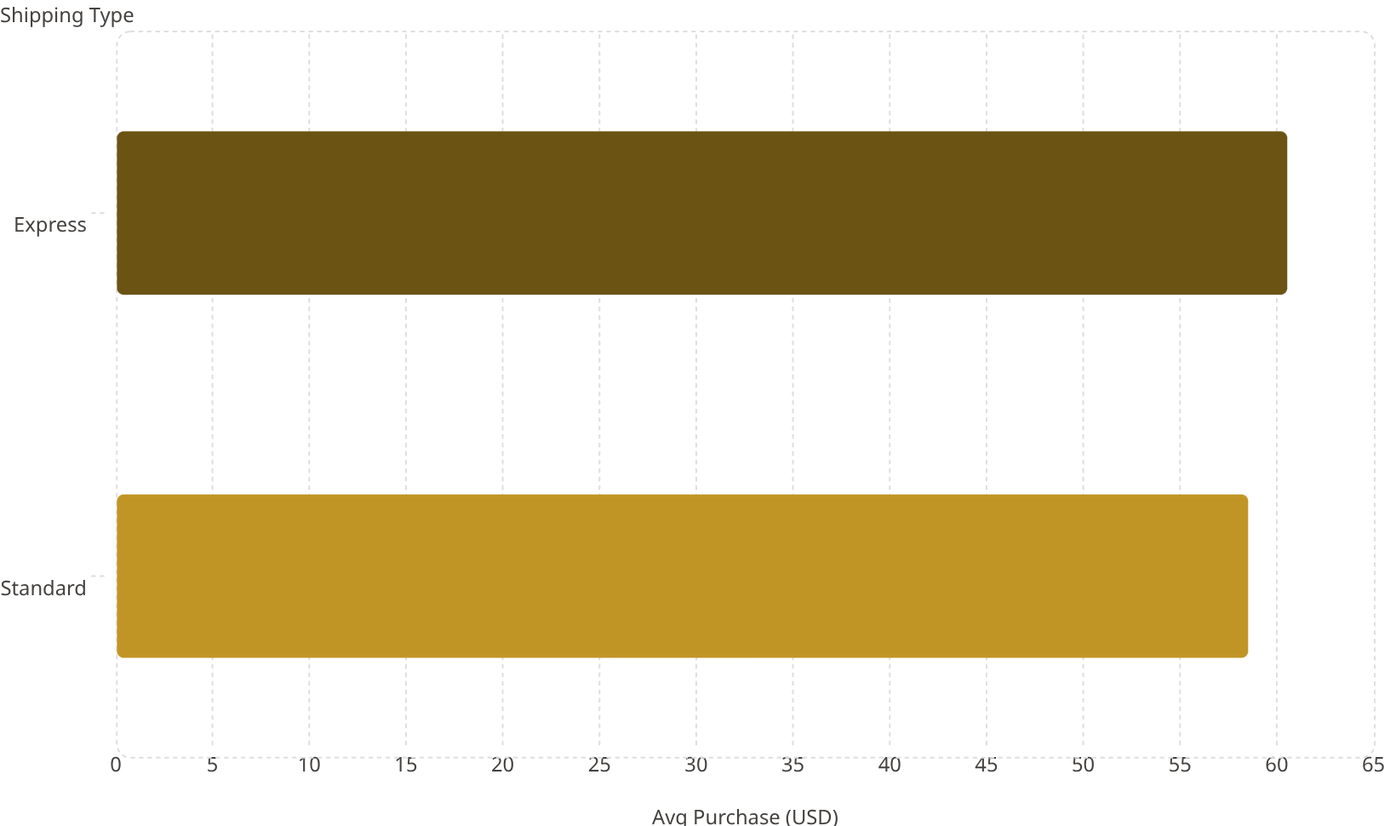

Shipping & Spending Patterns
839 High-Spending Discount Users
Customers who used discounts yet spent above average — proving discounts don't always erode basket size.
60.5
Express shipping users spend ~$2 more per transaction on average.
58.5

Slide 9
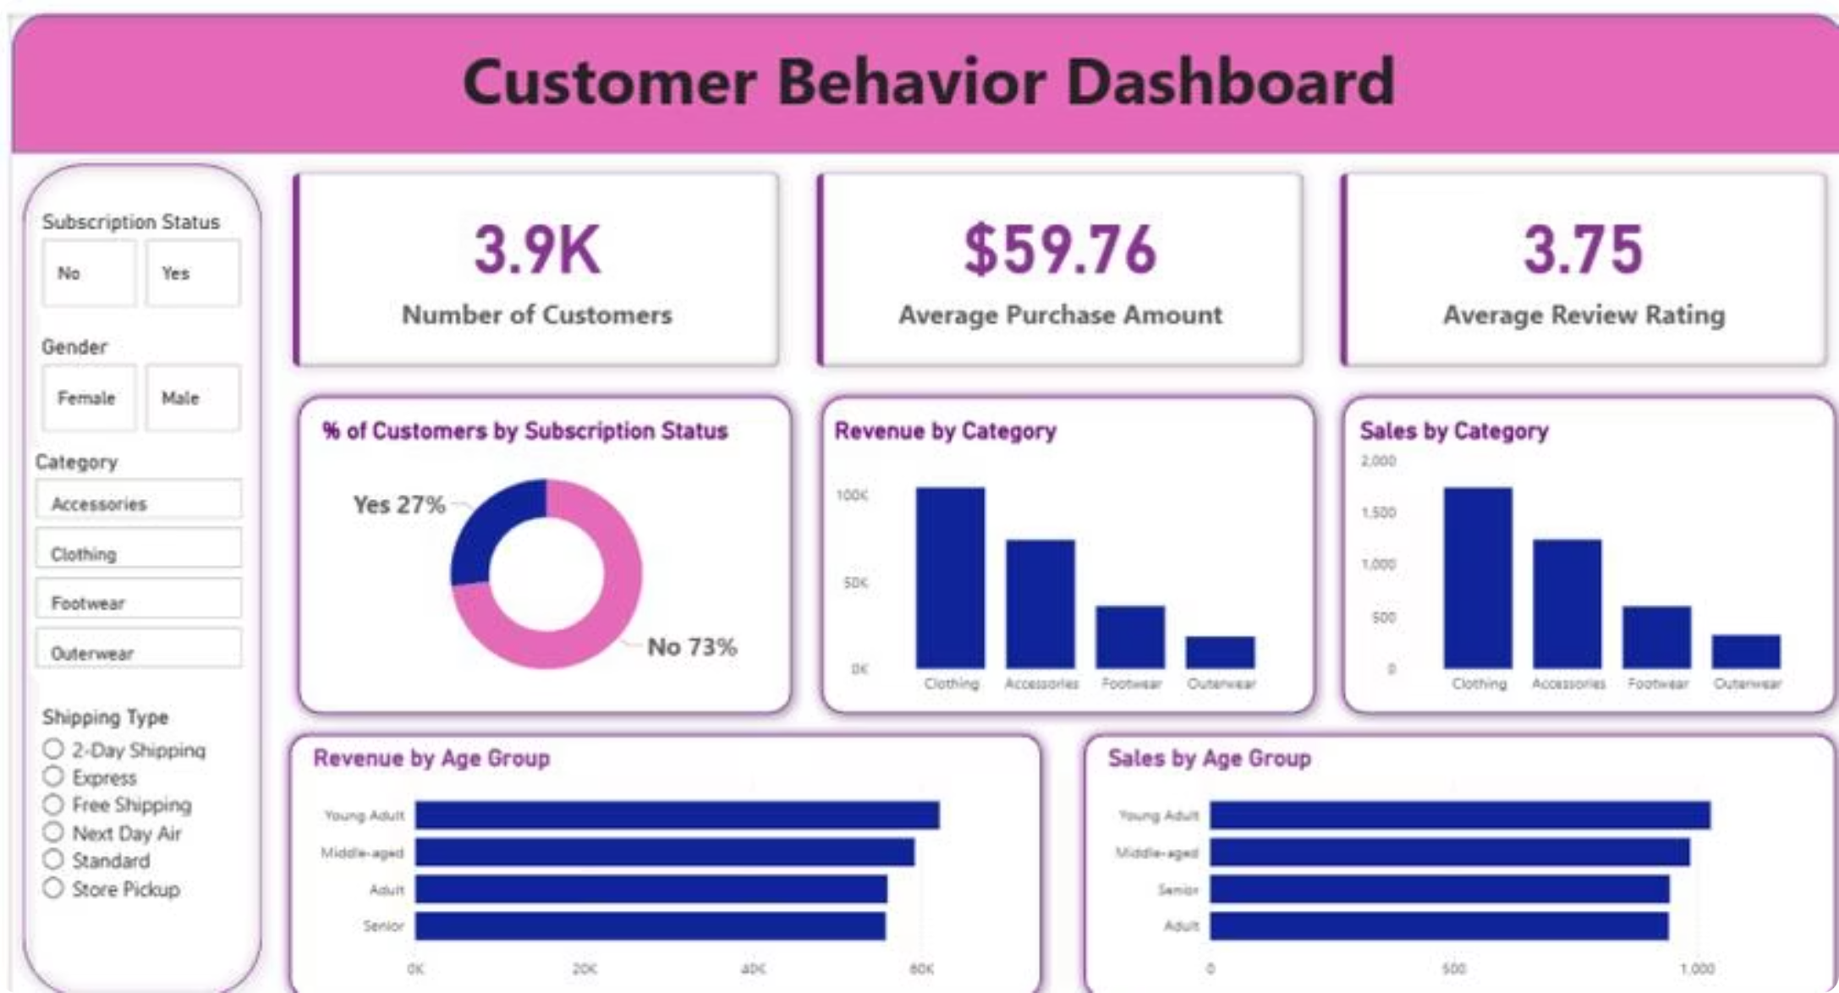
Power BI Dashboard
Interactive Filters
Subscription Status
Gender
Category
Shipping Type
Visualizations
Revenue & Sales by Category
Revenue & Sales by Age Group
Subscription donut chart

Slide 10


Business Recommendations
Boost Subscriptions
Promote exclusive subscriber benefits
Loyalty Programs
Reward repeat buyers to grow Loyal segment
Review Discounts
Balance sales boosts with margin control
Targeted Marketing
Focus on high-revenue age groups & express-shipping users

